Slide 1
ENETRAP III
Michèle Coeck (SCK•CEN)
On behalf of the ENETRAP III Consortium
EUTERP Workshop, May 7-9 2014, Rovinj, Croatia

Slide 2
Driving forces
Maintain and increase expertise in radiation protection
Legal framework
  Euratom Basic Safety Standards: Council Directive 2013/59/Euratom of December 5 2013, published on January 17 2014
  RPE, RPO, MPE (in replacement of QE in former BSS)
Common European goal:
  Clear and uniform terminology on professions in RP
  Common qualification criteria
  Common mutual recognition system for acquired competences of RP professionals
  Facilitating lecturer, learner and worker mobility across the EU
⇨ Common RP and safety culture

Slide 3
Some history – where do we come from? What did we already achieve? (What is still to be done?)
Euratom Council Directive 96/29/EURATOM
In answer to legal requirements: almost all EU member states and candidate states provided an E&T program, based on European BSS and the definition of “qualified expert”
BUT:
  Wide variety in terminology (QE, RPE, RPO, personnes compétentes, …)
  Wide variety of national approaches for E&T programs and for the recognition of “qualified experts” in EU member states
First approach to harmonization by ENETRAP FP6 (2005-2007)

Slide 4

First approach to harmonization by ENETRAP FP6 Most important realizations
EDUCATION
Establishment of Consortium of Universities → Launch of European Master in RP
ENETRAP questionnaire, resulted in an overview on:
    numbers of RPE's and RPO’s;
    identification of practices;
    national capabilities for E&T in RP;
    regulatory requirements;
    recognition.
Introduction of preliminary “ENETRAP training scheme”
Development of first E-learning module via MOODLE
Advise on implementation of OJT/WE
Supported by end-users and providers (via EUTERP)
TRAINING
Coordinator
SCK•CEN
Partners
CEA-INSTN
FZK-FTU
BfS
CIEMAT
NRG
ENEA
HPA-RPD
UJF Grenoble
NHC Scotland

Slide 5

ENETRAP II FP7
(2009-2012)
Results of ENETRAP FP6 were good, however, more work was to be done related to training:
Primarily dealing with RPE and RPO, but interested in medical field and the approaches used for MPE
Towards European reference training scheme for RPE, serve as basis for mutual recognition
Introduction of ECVET approach, learning outcomes in terms of K, S, C
Organization of pilot sessions
Development of draft/proposed frameworks and methodologies for national and international/mutual recognition of RPEs
Towards sustainable results via collaboration with EUTERP and HERCA
Coordinator
SCK•CEN
Partners
CEA-INSTN
KIT
BfS
CIEMAT
NRG
ENEA
HPA-RPD
ENEN Association
ITN
BME
UPB

Slide 6
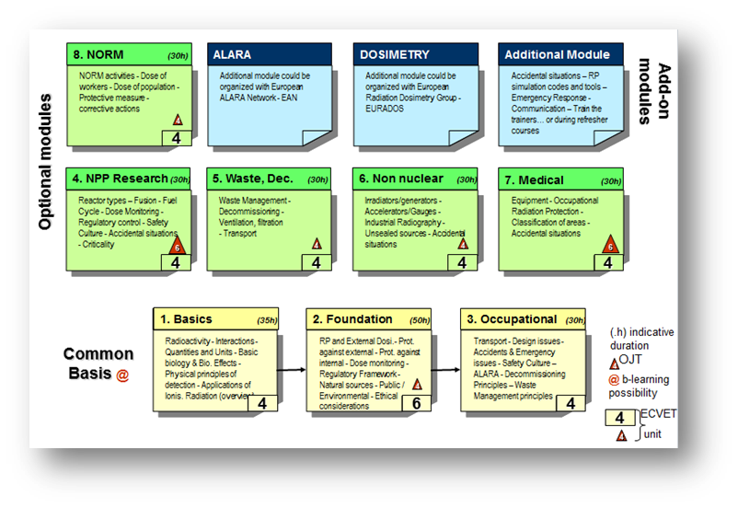

Slide 7
Lessons learned
In these projects: “policy” part as important as “development and organization of courses”, because of the legal requirements
Essential: publication of revised BSS, new definitions RPE/RPO based on advice that found its origin in ENETRAP and its connection to EUTERP
Essential: support of authorities (now established via EUTERP and HERCA) and stakeholders
Participation to European courses was difficult point - only when assurance that this course is “recognized” by authority
Introduction of ECVET: system was not yet used at higher EQF levels, in this project: “pioneering” this area, transparent management using “easy” tool will be helpful
Dissemination of results: important

Slide 8
What is still to be done?
Content of ENETRAP III
WP1 | Project coordination
WP2 | Organisation of “think-tank” activities and establishment of partnerships ensuring feedback from stakeholders
WP3 | Establishment of three specialized training modules for RPE and implementation of pilot sessions
WP4 | Development of a train-the-trainer (TTT) strategy and organisation of a TTT training event
WP5 | Dissemination of project results and contribution to a website for capacity building and transfer of know-how in radiation protection
WP6 | Testing of methodologies for RPE recognition and mutual recognition in practice
WP7 | Writing of guidance to support the implementation of E&T requirements for RPE and RPO as defined in the Euratom BSS

Slide 9
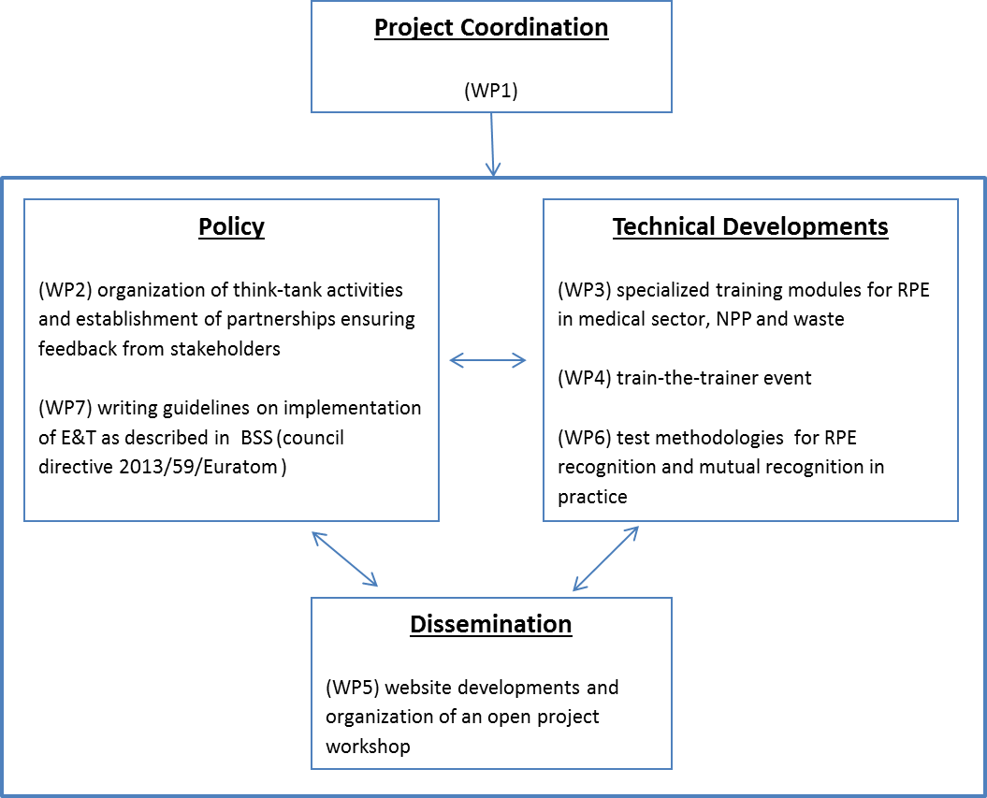
ENETRAP III

Slide 10
ENETRAP III innovative aspects
Revised BSS published → official definition RPE, RPO, (MPE) → write guidance for implementing E&T (initial + refresher training!) in national legislations
Continue to build the specialization topics of the RPE training scheme: RPE in NPP, medical and waste
Train the training: attention for quality of training techniques, scientific and technical competences, understanding of the European qualification frameworks (ECTS, ECVET, EQF, …), attention for broadening to non-scientific issues (transdisciplinary aspects, ethical aspects, …)

Slide 11
ENETRAP III innovative aspects
Transfer to other nuclear domains
Real cases to demonstrate mutual recognition methodologies
All involved either as partner or via Consultancy Group

Slide 12
Interaction with other projects, authorities and stakeholders
Consultancy Group
  HERCA, Art 31 GoE, DG ENERGY
  EHRO-N
  IAEA, IRPA
  EAN, NERIS, Radioecology Alliance, EURADOS
  FORATOM, (PGE Nuclear, EUTERP, EFOMP in Consortium)
  ENEN Association, ETKM SNETP, IG-DTP, MELODI
  …

Slide 13
In summary
ENETRAP III hopefully to start June 2014
4 years
Strong collaboration with end-users
Progress reported via
  ENETRAP3 website
  EUTERP website
  EUTERP Workshops
  Conferences (ETRAP and others)

