Slide 1
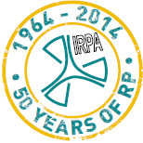
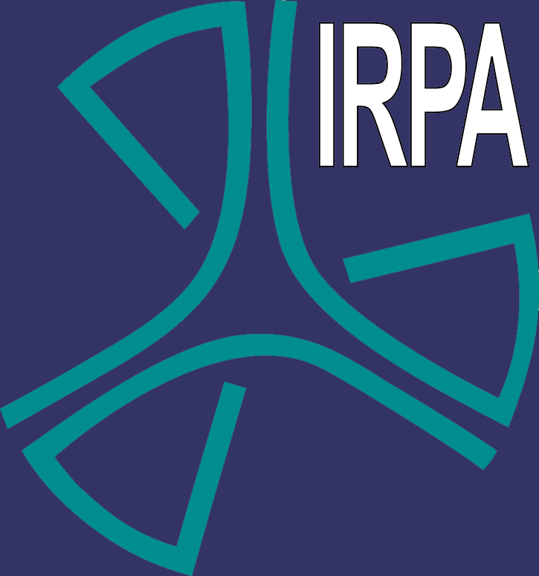
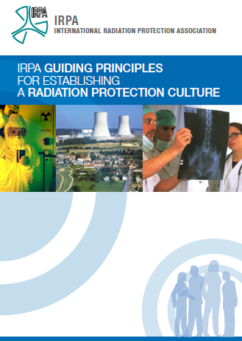
IRPA Guiding Principles for Establishing a RP Culture
Dr. B. Le Guen MD,
IRPA Executive Officer
International Radiation Protection Association
15th European ALARA Network Workshop and 5th EUTERP Workshop
Education and Training in Radiation Protection: Improving ALARA Culture
Rovinj, Croatia, 7th-9th May 2014

Slide 2
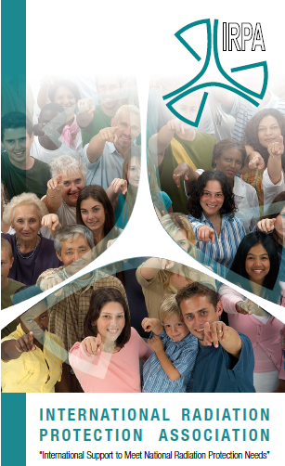
Role of IRPA :
To be the voice of RP professionals
49 Associate Societies representing 62 countries ;
Almost 18,000 individual members
Value and strength of IRPA:
Enormous resources of practical knowledge and experience in radiation protection and neighboring specialist fields
IRPA provide a medium for communication and advancement of radiation protection throughout the world
and has recognised the importance of establishing
a sound radiation protection culture

Slide 3
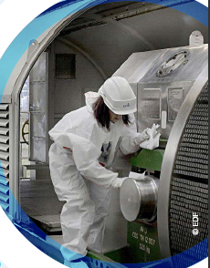
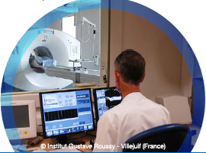

Goal ?
From nuclear industry to the medical sector, an IRPA RP culture Guidelines for professionals must be a common document about culture from the perspective of professionals, geared towards professionals
The purpose was to capture the opinion and standpoint of RP professionals on what a RP culture must be.
This statement has been developed in an inclusive and consultative approach

Slide 4
Questions during the IRPA meetings
What are the elements of the culture and how could we define it?
Is it possible to assess the RP culture and what could be the criteria?
How to engage the stakeholders (regulators, operators, professional organizations…) in the process of developing RP culture.
What is the role of RP professionals and IRPA AS with regard to RP culture?
How is regional culture included?
What are the criteria for success?

Slide 5
Safety Culture vs RP Culture
Safety culture is a concept that has been defined by different institutions, organizations, and there is a common understanding of its meaning
Safety culture includes nuclear safety, RP, occupational safety, security, health, environmental safety, …
Hence, RP culture in our organizations should be seen as the implementation of RP principles inside the framework of safety culture
RPC and SC should not be opposed. RPC is part of SC with peculiarities: both are looking at human errors and the human side of safety.

Slide 6

What is meant by Culture?
The ideas, beliefs and customs that are shared and accepted by people in a society.
That complex whole, which includes knowledge, belief, art, morals, law, customs, values, symbols, rituals and any other capabilities and habits, acquired by people as members of society that determine appropriate attitudes and behavior

Slide 7
Culture comes from three sources
  (1) Beliefs, values, and assumptions of the founders of an organization,
  (2) Learning experiences of group members as the organization evolves, (Groups of people who have shared significant problems, solved them, observed the effects of their solutions, and who have taken in new members)
  (3) Beliefs, values, and assumptions brought in by new members and leaders.

Slide 8
Why are we interested in a specific Radiation Protection Culture?
Embedding RP at a cultural level within an organization is by far the most effective way of delivering the performance to which we all aspire.
  To give visibility to the fundamentals of RP
  To promote radiation risk awareness (conscience)
  To promote shared responsibility among practitioners, operators, manufacturers, management and regulators
  To maintain the RP heritage
  To facilitate its transmission
  To improve continuously the quality and effectiveness of RP
  To contribute to the general safety

Slide 9
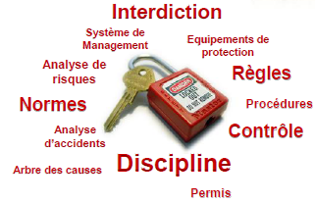
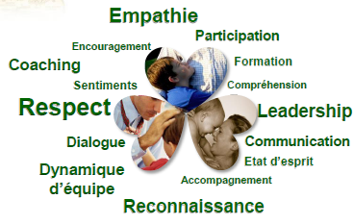
RP culture development and improvement
What are the ways to impact radiation protection culture?
  Strong leadership,
  Education and training,
  Establishment of a positive behavior at the working place ( Individual and collective behavior)
  A proper communication among all practitioners.
  Similarly, learning from events, incidents and near misses is an important part of culture development.

Slide 10
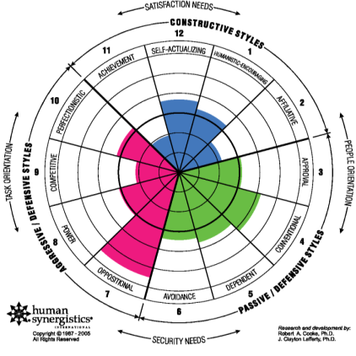
Assessment of RP culture - 1
A combination of quantitative and qualitative tools is required to assess the level and quality of radiation protection culture,
  not only to measure the identified criteria of success,
  but also to stimulate judgments and observations about positive or negative trends for such a given criteria
Assessment of RP culture relates both to internal and external rules

Slide 11
Assessment of RP culture - 2
At the local level, a RP application could provide for example:
  A formalized procedure to assure that the workers know the principles of RP
  A process to check if there is an established internal procedure for refreshing and for updating courses and training provided to workers and professionals.
  Formally entrust the position of the RP expert with the responsibility to teach and refresh theoretical and practical knowledge and RP related duties;
  Formalized self-assessments to evaluate the workers’ radiation protection culture and random checks via questionnaires filled in by the patients about radiation protection culture;
  Check first the existence of a blame-free policy to report and track errors and near misses in an open and constructive way.

Slide 12
Assessment of RP culture - 3
At the level of industrial third parties involved in the supply of RP equipment, the following tools can be applied:
  Measure the level of radiation protection culture among vendors of ionizing radiation facilities for nuclear medicine, radiotherapy, diagnostic imaging or industrial applications. This point may imply the involvement of a regulatory body;
  Establish a procedure requiring that vendors of ionizing radiation facilities or service providers in this area (maintenance, transportation of sources and other third-party services) should undergo an external independent audit to establish the existence of an appropriate level of radiation protection culture among the staff directly involved;
  Review relevant documents in order to provide information on the level of radiation protection culture.

Slide 13
Role of RP professionals
The RP practitioners must be aware that some interaction with wider stakeholders can assist in the development and application of workplace culture
The main stakeholders:
RP professionals need to:
The workforce (at all levels)
Senior managers and Directors
Contractors
Equipment manufacturers, vendors and suppliers
Regulators and other authorities
Medical and health professionals, especially but not exclusively those who are using ionizing radiation,
Functional leaders and risk managers
Patients
Display strong personal leadership and motivation
Develop a narrative on radiation protection in all exposure situations
Develop relationships with management, the workforce and the regulators
Consider following the NRC-style approach to develop a policy statement on radiation protection culture

Slide 14
Conclusion
Developing a “field culture” in addition to the “science, engineering or medical culture” is a way to anticipate problems and to obtain the commitment of all employees.
Radiation protection culture is a learned way of life.
It must be an ongoing dialogue
  Among safety professionals, organizational management and the workforce
  Between organizations and relevant stakeholders

Slide 15
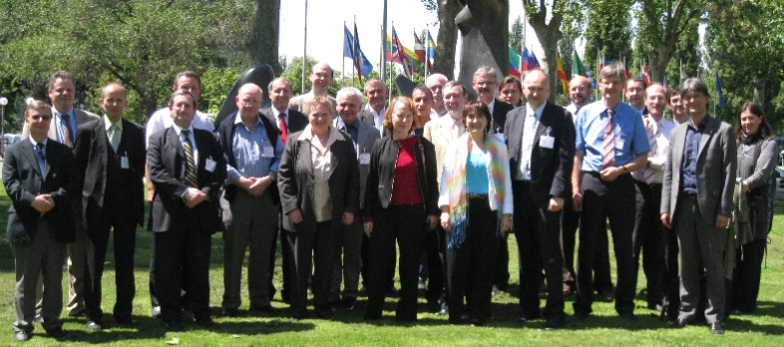
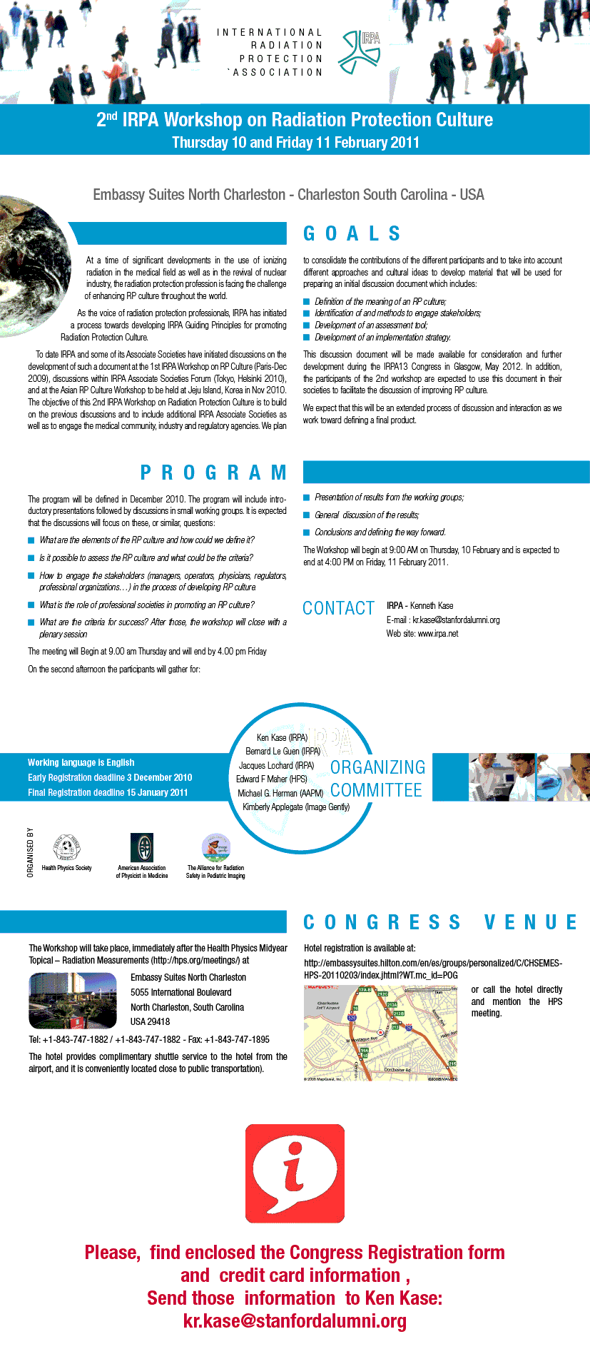

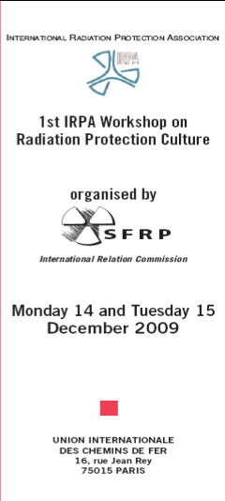
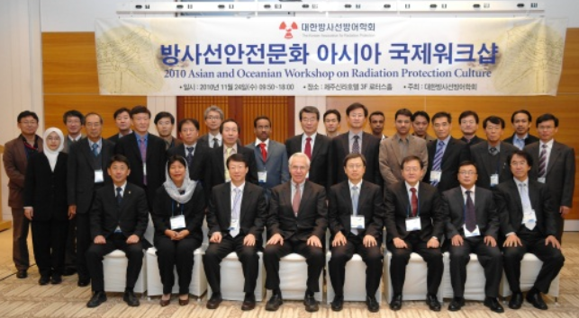
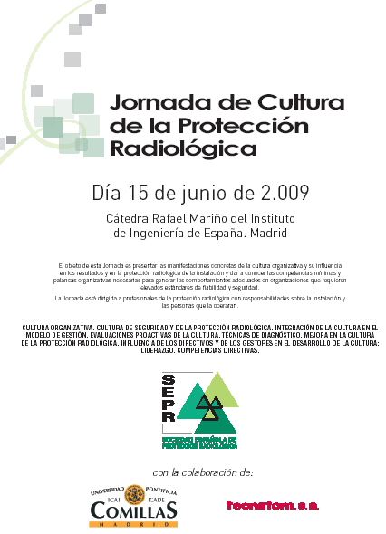



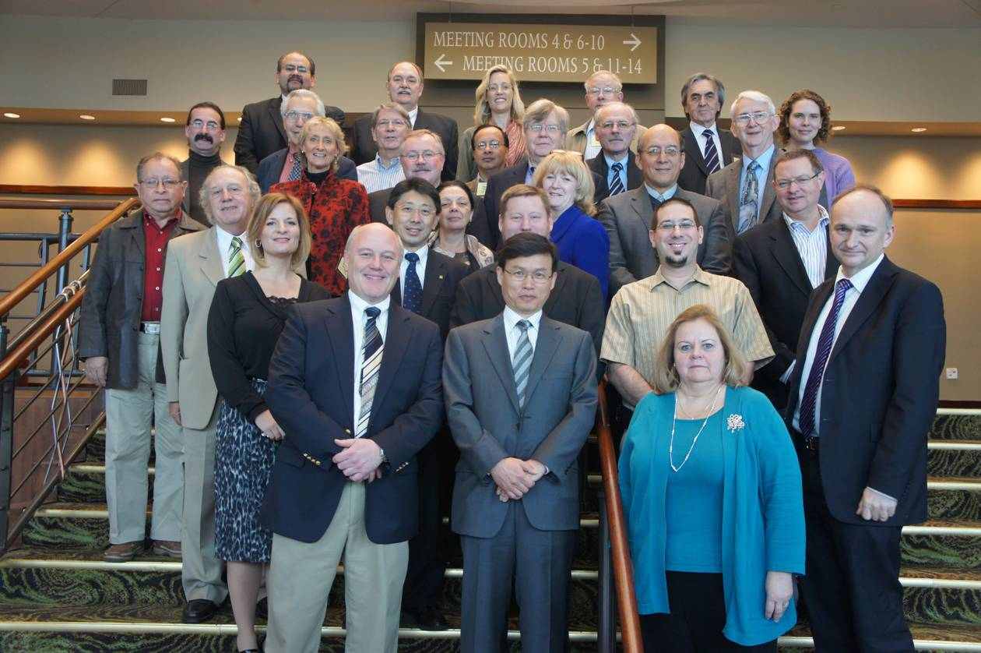
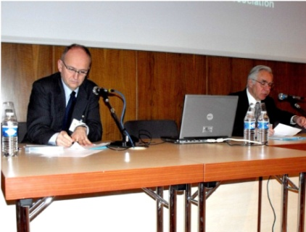





Enhancing RP Culture is a Process
IRPA is committed to publish a final set of Guidelines that incorporates approaches from different countries and regions of the world, from medicine, industry and regulators.

Slide 16
Conclusion
The aim is to present these guiding principles at regional congresses due to take place in 2014, which will provide an opportunity for celebrating IRPA’s 50th IRPA anniversary,
This guideline is a symbol for the IRPA anniversary,
“from the past toward to the future but with a common culture”
International Radiation Protection Association
http://www.irpa.net

