Slide 1
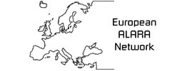


Recent Developments within the European Framework of RP Education and Training
Annemarie Schmitt-Hannig

Slide 2
Education and Training
  Education and training is in all areas everywhere in the world of outmost importance to perform work safely and to an given standard
  European Union: adequate and appropriate education and training activities are also the basis to achieve specific EU aims such as
    lifelong learning and
    borderless mobility
  In particular in areas where competence in radiation protection is crucial to avoid unneccessary radiation exposure of individuals, education and training in RP, together with appropriate work experience, is the key to build and maintain competence in RP.

Slide 3
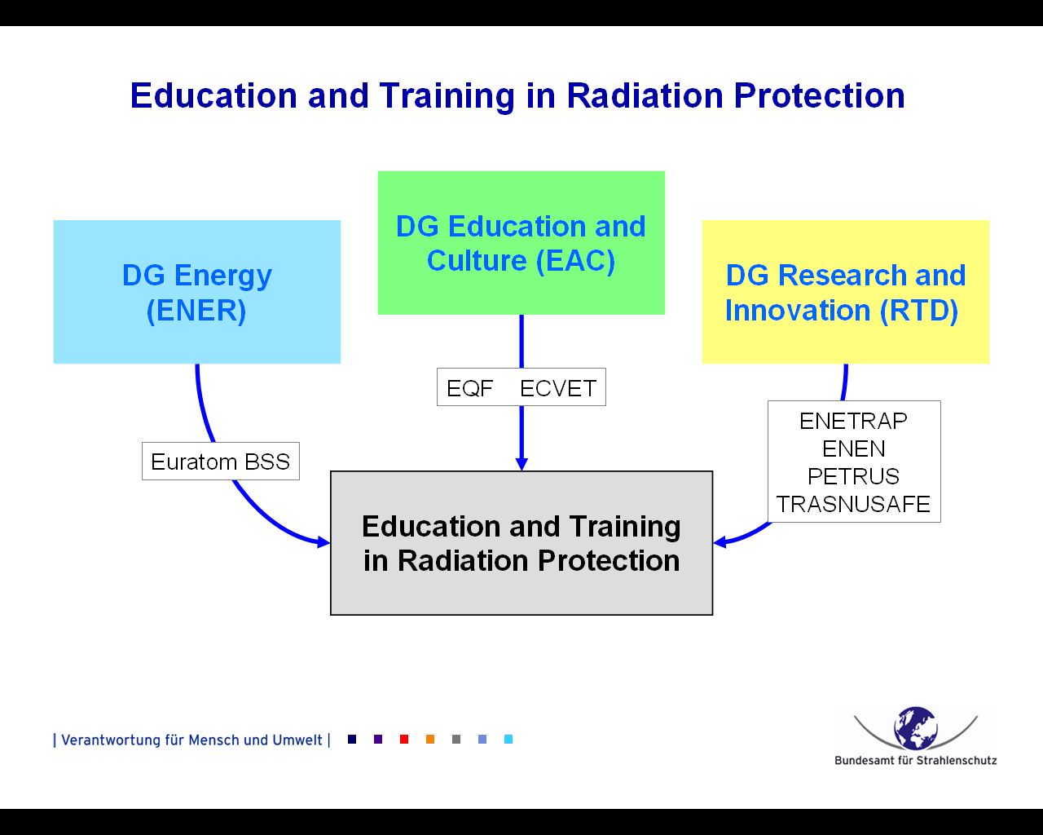

Slide 4

DG Energy – Radiation Protection
Euratom Basic Safety Standards (BSS)
Supporting Projects
EUTERP
(European Training and Education in Radiation Protection)
MEDRAPET
(Medical Exposure Directive Radiation Protection Education and Training)
Medical Physics Experts Project
EMAN (Medical ALARA Network)

Slide 5
DG Energy - Euratom BSS
Chapter IV: Requirements for radiation protection
education, training and information
Member States shall establish an adequate legislative and administrative framework for providing appropriate radiation protection education, training and information to all individuals whose tasks require specific competences in radiation protection. The training, retraining and information of relevant individuals shall be repeated at appropriate intervals and documented.
Member States shall establish education, training and retraining to allow the recognition of radiation protection experts, medical physics experts, occupational health services, and dosimetry services.

Slide 6
DG Energy - Projects in Radiation Protection
EUTERP (European Training and Education in Radiation Protection) => active as Foundation
Objective: to establish a general system for training and qualification in radiation protection and for the mutual recognition of diplomas awarded on completion of specific professional education or vocational training. => RPE + RPO
MEDRAPET (Medical Exposure Directive Radiation Protection Education and Training)
Radiation Protection Education and Training)
Objective: to provide an improved implementation of the Medical Exposure Directive provisions related to radiation protection education and training of medical professionals.
=> all medical professionals
Medical Physics Experts Project
Objective: to provide for improved implementation of the provisions of the Revised Euratom BSS related to the Medical Physics Expert (MPE) and to facilitate the harmonisation of the role, education and training of the MPE among the Member States of the EU. => MPE
EMAN (Medical ALARA Network) => active Steering Committee (ESR, EFRS, EFOMP)
Objective: to create a sustainable network where different stakeholders within the medical sector have opportunity to discuss and exchange information on topics related to the implementation of the ALARA principle in the medical field. => all stakeholders in the medical area

Slide 8
DG Research and Innovation
FP7 research projects in the area of
RP education and training
ENETRAP II radiation protection authorities, licencees
(RPE, RPO as required by Euratom BSS)
ENEN III nuclear facilities, nuclear systems suppliers
ENEN 2003, further development of nuclear expertise by E+T
PETRUS II radwaste agencies (e.g., waste repositories)
EU recognised training programme on geological dosposal for rwm
TRASNUSAFE health physics sector (e.g., ALARA principle)
design, develop and validate 2 training schemes on safety culture:
1. nuclear and 2. radiation based technology (incl medical sector)
(elements of transdisciplinary knowledge, such as perception of risk in society, ethical considerations, stakeholder participation, etc. should be
part of education and training in nuclear as well as in the medical area)

Slide 9
DG Research and Innovation
ENETRAP (European Network on Education and Training in Radiological Protection)
ENETRAP and ENETRAP II - achievements:
European Master of Radiation Protection (in cooperation with DG EAC)
Development of an RPE training scheme and of standardized training material
Development of European "reference standards" and good practices for education and training in radiation protection, on the basis of ECVET, specifically with respect to the radiation protection expert (RPE) and the radiation protection officer (RPO) in all sectors where ionising radiation is applied (industrial, medical, research).
Future efforts necessary: Develop guidance documents to support implementation of BSS requirements on E+T of RPE and RPO, establish links to MPE and workers, in consultation with EFOMP and other professional associations and stakeholders.
ENETRAP III => starting soon

Slide 11
DG Education and Culture
Recommendation of the European Parliament and of the Council of 23 April 2008 on the establishment of the
European Qualifications Framework For Lifelong Learning (EQF)
Aim: create links between national qualification systems, making competences and qualifications more transparent
Recommendation of the European Parliament (18 June 2009) on the establishment of a
European Credit System for Vocational Education and Training (ECVET)
Aim: make qualification systems compatible by providing an interface between existing national provisions on the accumulation, recognition and transfer of credits (complements ECTS)

Slide 12
European qualifications framework
For lifelong learning (EQF)
The EQF is a common European reference framework which links countries’ qualifications systems together, acting as a translation device to make qualifications more readable and understandable across different countries and systems in Europe. It has two principal aims: to promote citizens’ mobility between countries and to facilitate their lifelong learning.
EQF encompasses all levels of qualifications acquired in general, vocational as well as academic education and training. Additionally, the framework addresses qualifications acquired in initial and continuing education and training.

Slide 13
European qualifications framework
For lifelong learning (EQF)
The eight reference levels of the EQF are described in terms of learning outcomes. The EQF recognises that Europe’s education and training systems are so diverse that a shift to learning outcomes is necessary to make comparison and cooperation between countries and institutions possible.
In the EQF a learning outcome is defined as a statement of what a learner knows, understands and is able to do on completion of a learning process. The EQF therefore emphasises the results of learning rather than focusing on inputs such as length of study. Learning outcomes are specified in three categories as
knowledge, skills and competence

Slide 14
European Credit System for
Vocational Education and Training (ECVET)
Towards borderless mobility and lifelong learning
for the continuous improvement of competencies
Faced with challenges such as intensified global competition, high numbers of low-skilled workers and an ageing population, vocational education and training (VET) is vital to prepare individuals for today's society and ensure Europe's future competitiveness and innovation.
ECVET is aimed at facilitating the transfer, recognition and accumulation of
assessed learning outcomes of individuals on their way to achieving a
qualification
portfolio of learning outcomes or “European Nuclear Competence Passport”

Slide 15
ECVET - Learning outcomes
to acquire specific competencies
in sectors where radiation is applied
ECVET definition: "learning outcomes" means statements of what a learner knows, understands and is able to do on completion of a learning process
"Learning outcomes" should be achievable through a variety of education and training paths (be they in a formal, non-formal or informal context)
“Learning outcomes” refer to specific competencies and consist of a mix of:
  - Knowledge (Learning to know)
  (needed to support operational and technical decisions)
  - Skills (Learning to do)
  (translation of safety culture into practical terms)
  - Competence (Learning to work together and/or Learning to be)
Points: 60 ECVET points analogous to 60 ECTS points for higher education
Difference: ECVET is based on learning outcomes, whereas ECTS is based on time spent in course and/or in laboratory exercises
=> ECVET is an important tool for “mutual recognition”

Slide 17
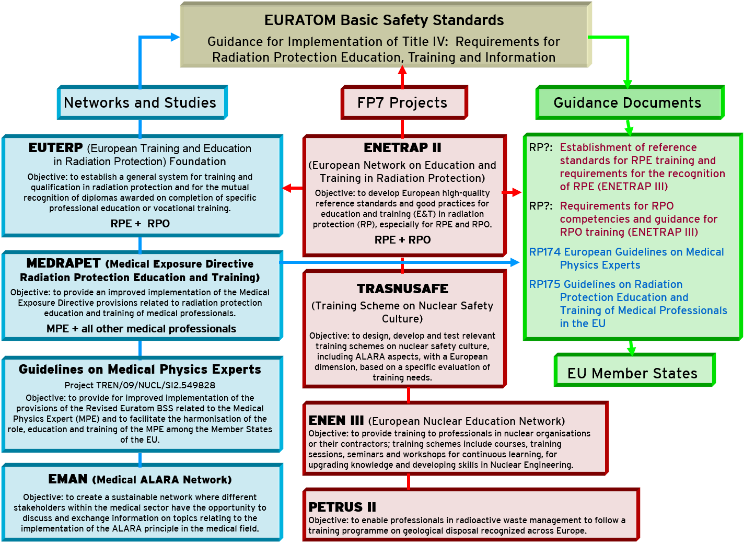

Slide 18

DG ENERGY – SET-Plan (2007)
Strategic plan to accelerate the development of
cost-effective low carbon technologies
These projects, together with others, will form an integral part of the EU strategy, Europe 2020, requiring more effective investments in education, research and innovation.
SET-Plan (European Strategic Energy Technology Plan)
“Education and Training Roadmap” (Draft June 2013)
Key education and training activities to assist the development of the necessary cooperation frameworks among academia, research institutes and other partners.

Slide 19
Education and Training Roadmap
The strategy includes support for lifelong learning and borderless mobility, in particular, to ensure multilateral exchanges. Obstacles preventing the mobility of qualified experts should be removed (e.g. national regulations regarding specific job qualifications).
The development of master courses is proposed which should be open to Continuous Professional Development (CPD) programmes in line with the European Qualification Framework (EQF), bridging ECTS (European Credit Transfer and accumulation System) and ECVET (European Credit system for Vocational Education and Training).
Professional training networks are supported in all areas of the energy sector, one of them being the “nuclear sector” where medical applications of ionising radiation are included.

Slide 20
DG Research
and Innovation
Euratom Research Programme
FP7 => Horizon 2020 (start: 2014)
Parts of Horizon 2020 are based on the Euratom Treaty, therefore, Horizon 2020 is complemented by the
Council Regulation Euratom Programme 2014-2018
COM (2011) 812 final, 30 Nov 2011
The European Atomic Energy Community (Euratom) is legally separated
from the European Community (EC) and has its own Research Programme
(managed by the common Community institutions)

Slide 21
Euratom Programme – complementing Horizon 2020
General objective: to improve nuclear safety, security and radiation protection and to contribute to the decarbonisation of the energy system in a safe, efficient and secure way
  Specific objective:
  to foster radiation protection, one of the cross cutting activities
  => NFRP 7 – 2015: Integrating radiation research in the EU => EJP
  Specific objective:
to foster knowledge management, education and training
=> NFRP 10 – 2014: Education and training (Bologna and Copenhagen processes)

Slide 22
Euratom Programme – complementing Horizon 2020
Call for proposals H2020-NFRP-2014/2015
  NFRP 7 – 2015: Integrating radiation research in the EU => EJP
European Joint Programme (Co-fund Action: 50% EC / 50% Consortium)
RP Research Programmes Owners and Managers
+
MELODI (Multidisciplinary European Low Dose Initiative)
NERIS (European Platform on preparedness for nuclear and radiological emergency response and recovery)
ALLIANE (European Radioecology Alliance)
EURADOS (European Radiation Dosimetry Group)
+
Linked third parties
E&T activities are an important part of the EJP !

Slide 24
MELODI WG on E&T Meeting - April 2014
Multidisciplinary European Low Dose Initiative
Main WG task:
to formulate a strategy for E&T activities in the low dose area in line with the EQF under two key aspects: practical E&T activities (e.g. continuation of DoReMi Courses, summerschools) and policy-related activities (e.g. integration of the MELODI E&T strategy into the SET-Plan E&T Roadmap of DG Energy and cooperation with the EHRO-N activities of the JRC)
Up to September 2014:
to formulate a strategy for MELODI E&T activities within the planned EJP (NFRP 7) in such a way that E&T activities of the other RP platforms can be integrated
Up to September 2014:
to formulate a strategy for MELODI E&T activities within a new E&T project proposal together with the EURATOM Technology Platforms (NFRP 10)

Slide 25
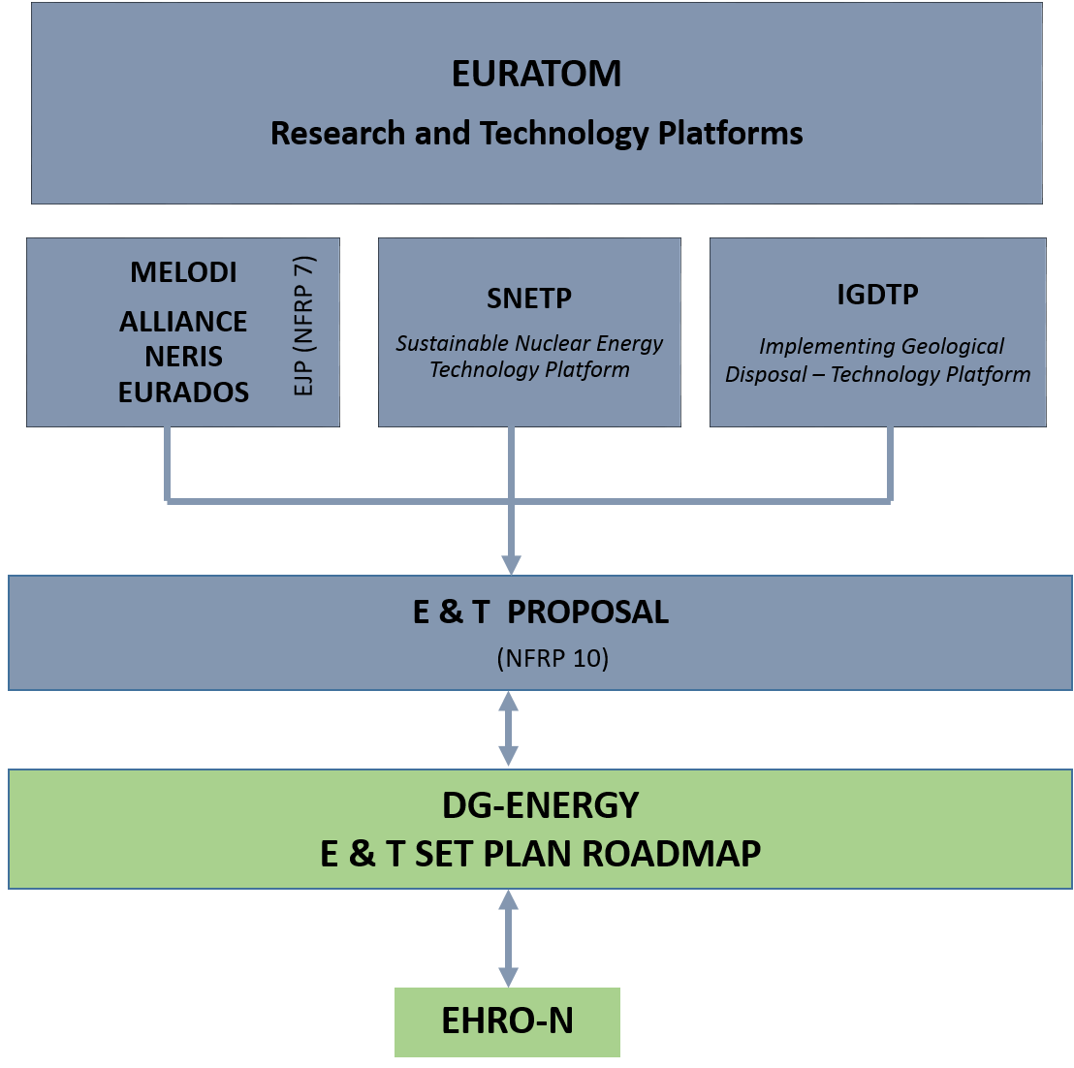

Slide 26
HERCA - Task Force on E&T 2013
Heads of European Radiological protection Competent Authorities
Recommendations - Radiation Protection Expert (RPE):
EC should develop guidance for the implementation of the BSS requirements for RPE
HERCA Member Countries should provide input to the development of the guidance (=> ENETRAP III)
HERCA should recognise this guidance as reference for HERCA MC (to be followed by national authorities)
After BSS have been implemented and guidance developed: a new HERCA survey should be done
Depending on the results, HERCA might develop a mutual recognition system for RPE

Slide 27
HERCA - Task Force on E&T
Heads of European Radiological protection Competent Authorities
Recommendations - Radiation Protection Expert (RPO):
EC should develop guidance for the implementation of the BSS requirements for RPO (role of the RPO and required competencies)
HERCA Member Countries should provide input to the development of the guidance (=> ENETRAP III)
Recommendations - E&T of workers
Guidance for RPE and RPO should include information on RP training requirements of workers

Slide 28
THANK YOU FOR YOUR ATTENTION

Slide 29
DG Research and Innovation
Technology and Research Platforms
Multidisciplinary European Low-Dose Initiative (MELODI)
=> To coordinate R&D in the area of low dose radiation risk
OPERRA (Open Project for Europ. Rad. Research Area) => to build up an umbrella coordination structure to administer future calls for research in radiation protection on behalf of the European Commission. MELODI will take the lead with the support of Alliance, NERIS, EURADOS, EURAMET, EUTERP, etc. as equal partners.
Sustainable Nuclear Energy Technology Platform (SNETP)
=> To coordinate R&D in the area of nuclear systems & safety
Implementing Geological Disposal-TP (IGD-TP)
=> To coordinate implementation-oriented R&D activities key aspects of deep geological disposal of spent fuel and long-lived radioactive waste with the vision to operate in Europe a geological repositories for HLW by 2025

