Slide 1
Assessing the effectiveness of training
- what are we looking for ?
EAN/EUTERP Workshop, Rovinj, 7-9 May 2014
J E Stewart
PHE-CRCE( Leeds) UK
Notes:
The objectives should be stated

Slide 2


Overview
What is meant by “effective training” ?
    Who is “effectiveness” important to?
        When is the answer needed/of value ?
          How do we know if training has been effective or not ?
I’m top of the class !

Slide 3
What is “effective training” ?
Single training event
Industry specific programme
Training scheme
National E&T strategy
..results in the intended outcome…

Slide 4
..important to be clear of intended outcomes …..
“Training” | Nature of “Outcomes”
Single presentation | Generally specific/well defined, eg Know the dose limits Understand “contamination” Able to calculate dose-rate , etc
Industry Programme eg PCN | Relevant to an application and a particular workforce (but multiple levels), Ensuring competence , safe working Low incident rate ALARA within the industry
Training Scheme eg RPE, | More wide reaching , Building competence Capacity building
National E&T Strategy | “Big Picture” Sufficient number of appropriately competent individuals (all levels, all sectors) ALARA attained ?

Slide 5

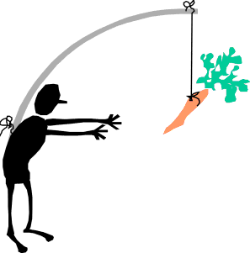
Government
Workers
Safe nation
Reputation
Trainers
Impact ?
Regulators
Obligation
feedback
Address needs
Compliance
Who is effectiveness important to ?
Good practice
Less work
Motivation ?
RPOs
Employers
Eases supervision
Communication
Compliance
RPEs
Regulator happy
Informs advice
Public
Safe workforce
Communication
££££
Less work

Slide 6


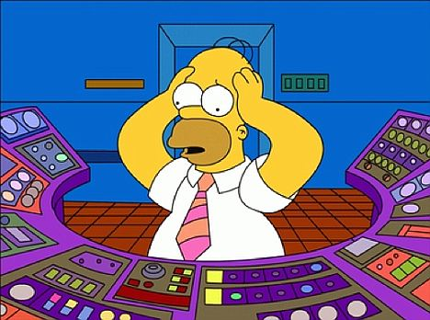
Feedback Sheet
Quality of trainers 5/5
Quality of Notes 5/5
Donuts 5/5
Duration 5/5
Price 5/5
Springfield Training Co.
..when and how to assess….. ?

Slide 7
Example 1:
Individual being trained as an RPO. The training consists of :
  Attendance at an RPO course (4 days)
    Presentations + exercises + exam
  period of on-the-job training
Who assesses the effectiveness of this training ?
What are the KPI ?
(ALARA ?)
How are these KPI captured ?
Who needs the data ?

Slide 8
Example 2:
“A N Country” has established a National strategy for E&T in
radiation protection.
Who assesses the effectiveness of the strategy + associated training programmes ?
What are the KPI ?
How are these KPI captured ?
Who needs the data ?

Slide 9
Numbers of OEW ?
Dose data
Number of incidents ?
…KPIs … ?
Inspection Reports
Nature of incidents ?
Exam passes
Numbers trained ?

Slide 10
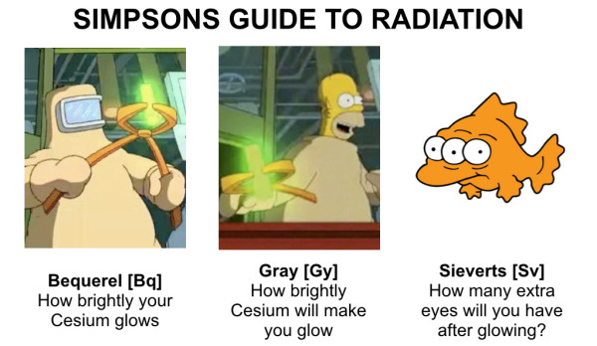
What is the evidence that training in radiation protection has been effective …?
Do we have the resources to get it …?

Slide 11
Assessing the effectiveness of training
- what are we looking for ?
EAN/EUTERP Workshop, Rovinj, 7-9 May 2014
J E Stewart
PHE-CRCE( Leeds) UK
Notes:
The objectives should be stated

