Slide 1
Testing the Effectiveness of Training
- a practical solution
E L Grindrod; J E Stewart
PHE CRCE Leeds

Slide 2
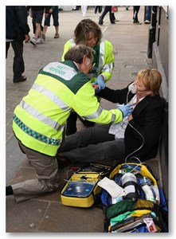
How to test the effectiveness of training?

Slide 3
The participants:
Fast-thinking / fast acting, looking for a quick ‘black / white’ solution
Highly practical
Team players: collective decision-making
Comfortable seeking and implementing expert advice
Focussed on colleagues and the patient

Slide 4
Expected outcomes of the course:
Identify a radiation hazard and evaluate its significance
Ensure compliance with employer’s policies
Liaise with other parties:
premises owners;
other agencies;
RP experts

Slide 5
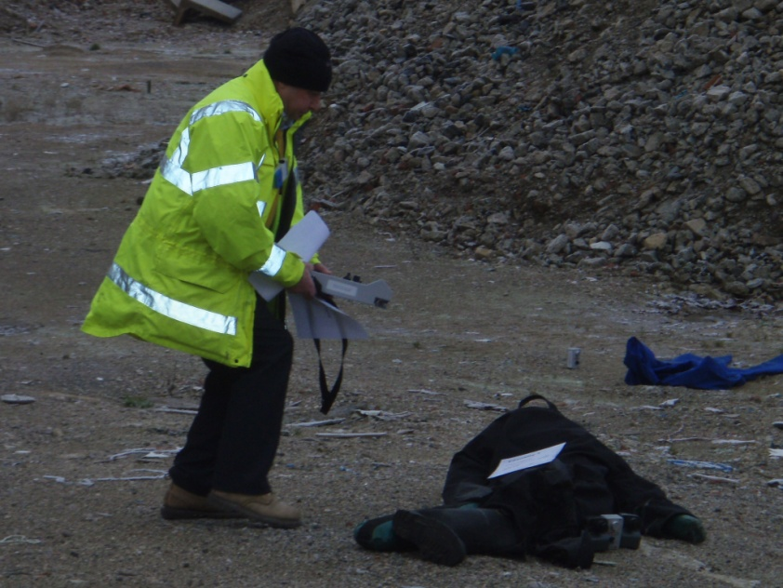

Slide 6
Assessment

Slide 7

Assessment considerations
Expected course outcomes
Nature of the participants
Varied / unexpected role
Resources available: hardware, time, personnel
QA and an ‘individual’ decision

Slide 8
Our current solution
Part 1: Multiple choice (20% of total score)
Part 2: Short answer questions (60% of total score)
Part 3: Practical assessment of skills (20% of the total score)

Slide 9
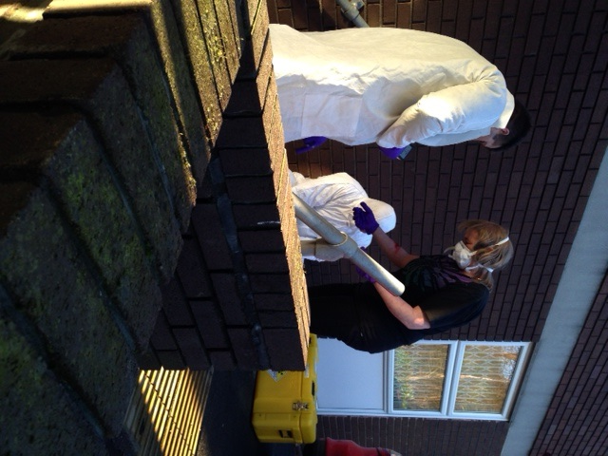
Practical Assessment

Slide 10
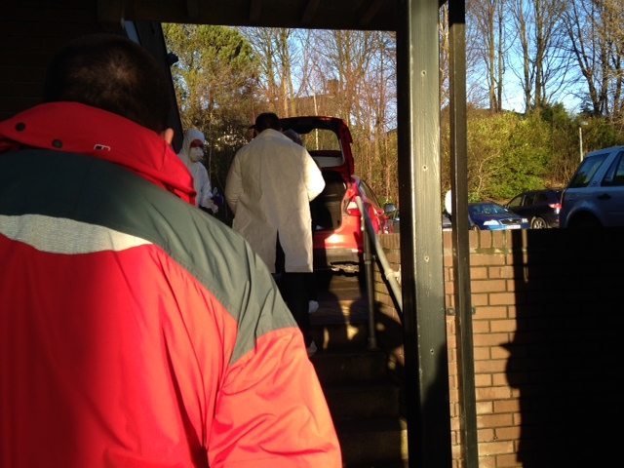

Slide 11
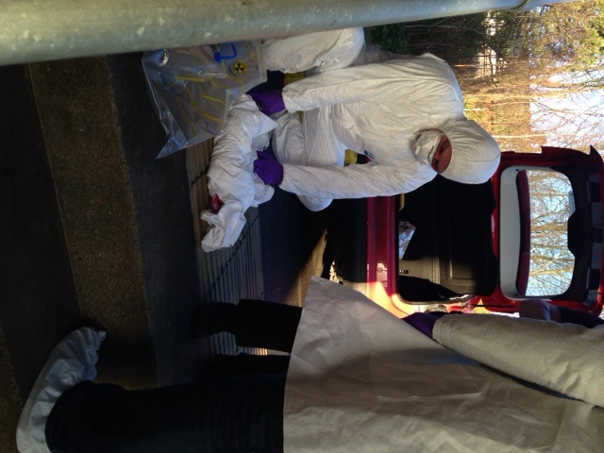

Slide 12
Issues
Ideal
Individual
Appropriate
In practice
“Good enough”
Appropriate
Resources
Quality assured
fair
Fair outcome
Time / resourcing
Appropriate assessment (testing the right thing)
“Optimisation”

Slide 13
Solutions – the future ?
“Streaming”
Individual practical assessment
Viva assessment
Pass / fail judged on written performance only
No change?

Slide 14
Testing the Effectiveness of Training
- a practical solution
E L Grindrod; J E Stewart
PHE CRCE Leeds

