Slide 1
How to integrate the « Humans factors » within a reviewing project of the HP training for outside workers?
PowerPoint 2003
Pour appliquer ce modèle à
une présentation existante :
supprimez toutes les diapos de ce document,
puis, menu [Insertion],
"Diapositives à partir d'un fichier",
cliquez sur [Parcourir],
sélectionnez le fichier,
cliquez sur [Tout insérer].
NB : ne pas cocher "Conserver la mise en forme d'origine" en bas de la boîte de dialogue.
Isabelle Fucks EDF R&D, Alexandre Riedel EDF, Gérard Cordier EDF, Alain Quiot EDF, Damien Gousy SIFOP
8 MAY 2014 ROVINJ CROATIA
Notes:
The presentation will try to develop, and to share with you, a main idea: it’s possible to take into account HF dimensions within the design of training program but it needs to share and make evolve some basic “assumptions” about how people learn and “what’s the best way to design a training program?”

Slide 2
SUMMARY
PowerPoint 2003
Pour remplacer le titre et la
date en pied de page de
toutes les diapos :
menu [Affichage],
"En-tête et pied de page"
dans le champ "Pied de page", remplacez le titre et la date,
cliquez sur le bouton [Appliquer partout].
Context
What doe’s it mean to integrate HF within the design of a training program?
The evolutions of the training design
Conclusions
Notes:
The presentation is divided into four part :
The context of the training program revision. I will indicate who are the learners considered in this project and what EDF want to learn to them ?
Second, I will try to explain what does it means to integrate HF dimensions into the design of training program
Third, I will expose the main changes and challenges within this program resulting from this HF approach
Fourth, I will discuss some conclusion

Slide 3

Context : a new program training to face EDF challenges
CONTEXT
  Renewal of the outside workers
  Feedback process indicates that training can be improved : the meaning of the rules must be improved
  Future big program of NPP revision
  Strengthening of regulatory expectations
CHALLENGES : to improve the workers practices & behaviors, in risk prevention to contribute to a nuclear sector which is exemplary and socially responsible
Design/test
Integration within the training companies
1/09/2014
Starting up
A TEAM PROJECT IS ORGANISED TO FACE THE CHALLENGE
2012 2013 2014
Notes:
In the next and soon future, EDF will face a specific context which characterized by four simultaneous data : the renewal of the outside workers who realize the revisions of the NPP and a big program of technical revisions. In this context, the competences and the skills of people to work in a nuclear industry with all its specificities become a challenge for EDF…
So this context create the opportunity to open and begin a reflection about the training program.
The project began in 2012 and now, we are very closed to the starting up.

Slide 4


Context : the complexity of the project
Some facts
  The training program relates to “safety topics”:
    radiation-protection,
    classic safety
    industrial safety
    environment
    fire
  23 000 outside workers with different technical jobs
  21 000 outside workers operating in radiological areas
  In 2013, 6000 outside workers are trained
  12 outside training companies
  250 trainers
Stakeholders
involvement
Operational needs &
Constraints and limits collected : compromise
Notes:
Even the objectives is simple to present, the path to reach is, at the opposite, complicated regarding with which to deal with:
The very broad fields/risk domains
Workers with different technical job
12 Training center
250 trainers…
So to face this complexity and to build a new safety training program acceptable, EDF decided to bring together stakeholders (representatives of outside companies and training companies). Their involvement is considered as a key success to facilitate the introduction of big changes. Safety is a shared product, training is a part of it, so EDF want to make possible to representatives to take part to this project.

Slide 5

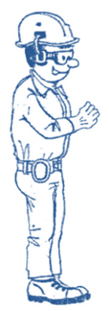
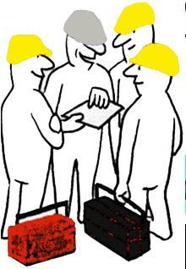

who do we need to train?
Outside workers with 2 levels of mission: the classic worker and the « job leader », the one in charge of « safety » missions (control actions and son…).
We go from a “cumulative” program to a “training process”
Level 1 : classic worker
Level 2 : Job leader
Notes:
Everybody who worked in a nuclear industry learned how much a classic and technical work is specific when this work is realized in a nuclear environment. Each step of the work is different because safety leads to a high level of requirements, of control, of quality…and so on.
The goals are than well defined: each new worker and each worker must be train to a set of common nuclear knowledge (safety culture, the functioning, quality assurance, and so on) and to a large set of risks. EDF want also to distinguish clearly two level of training and authorizations : the “classic” worker and the job leader : the one who is in charge, within the work area, of the technical operation and the safety of the team.

Slide 6
The two levels of training
Objectives of the level 1 “classic” worker
4 days training
To locate
To identify and comply with/use local rules
Objectives of the level 2 “the job leader”
4 days training
A worker whose able to work alone within a radiological area and who pay attention to the team safety
To protect himself
Notice : additional and specific trainings are provided to outside working relating to specific safety equipments

Slide 7

What does 'it mean to integrate human factors within the design of training ?
The « idea » is easy:
 Consider the results and the knowledge from educational sciences to adapt and transform the training design
Adults learn only what they need to face/resolve daily problem
Adults are characterized by “an existing experience” : a starting point
Notes:
First before presenting you this communication, I would like tell you some words about the human group within the Research and Development Division within EDF. This group gather together social scientists who are in support of the Division of the nuclear production. We take part in long term project. So for 10 years, I realized some analysis and researches within the HP field to understand why people comply with such HP rules and why they do not comply with others. So I had the occasion to follow and to observe outside workers meanwhile they work. I gathered a lot of operational information about their work, what are their constraints, their goals, their relations with representatives of EDF, and so on. This specific framework explains, partly, the origin of my participation within the revision project of the training for the outside workers.
Social sciences have produced a lot of results and knowledge about “How adults learn”. The purpose is than obvious. The design of the training program should be based on these specific lessons. Educational sciences teach us that adults do not learn as the children. There two main differences between the children and the adult learning. The adult are characterized by firstly an “economic and rational approach”: they learn what they need to face the daily life, the fixe regular problem. By contrast, children learn to comply with the expectations of their teacher, to please their parents. Adults do not work, not function like. Second, adults have a package of “existing knowledge and experience” which already there and which help them to work daily and fix problem. So the training should refer to this existing package, links should be created to appeal adults. By constrat, children have so much to discover, they are curious and they accept/learn a lot of things.
Albert Einstein : “The only source of knowledge is experience” and “Information is not knowledge”….and so long “It’s a miracle that curiosity survives formal education….”

Slide 8


evolution of the paradigm about the training
The blackboard model
The tools box model
60 % of the training are practical : training plateform; studies case, resolution problem exercises,…
Notes:
So when we take into account these two simple and brief lessons : the model, the paradigm of the training is changing.
We come from a “classic” model, the blackboard model where people comply with rule only because they are enacted. So the training is often a set of knowledge to transfer and practices to show. Workers seem only need to listen and observe to “know” how to safely work. But in real life, or “real workers” are not like that. They learn by understanding, doing and resolving problem and …they learn often what they will need usually, normally. In this model, the training is a “tool box”.
In this model, the training should be a set of practical cases, significant knowledge relevant for resolving case studies

Slide 9
What we try to do ?

Slide 10


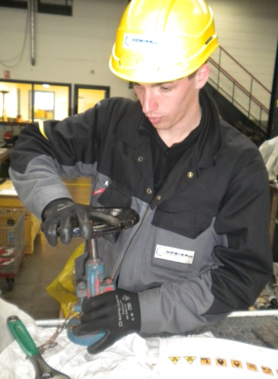
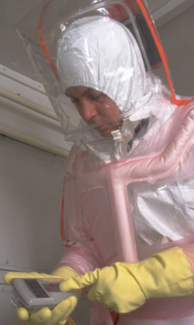
A fundamental switch to operate : the openness of the design training process
The expert model to the « expert – Professional model »
+
The real and daily work becomes one filter (among others) to select the theoretical knowledge to integrate/keep in the training program : is that knowledge linked to a practical action?
Notes:
So to concretize the tools box model, we need to identify what workers need to work safely. Therefore, experts, the rules makers are the only to consider. We need to open the design process to new shareholders : representatives of workers, of trainers and also a specialist in “human factors” to make it run. Everyone has so fare a specific mission : meanwhile experts and rules makers were expected to indicates what rules we are talking about, the knowledge, the representatives of workers take part in the identifications of practices, priorities, their operational need. And the role of the human factor specialist had to bring some operational information, a description about work conditions, the environment to complete the way to teach about rules, to help to the compromise.

Slide 11


Evolution of the meaning of the rule : from constraint to a “tool”
Without an operational meaning, rules remains theoretical and abstract things, but with a work meaning, they become useful
Guideline for the designers & trainers : the operational well-founded of the rules must be explained in terms of individual, collective safety, short and long term issues
Notes:
This first switch into the design process lead firstly to the evolution about the way “how talk about the rule”. This evolution is required to talk about rule in a way “which make sense” for workers. Than the image of the rule has to change. If for managers, the rule is a way, a mean to make control behaviors, it’s not the most adapted speech for workers. They won’t comply with the rule to please the managers, they will comply with them because they are useful. So the best way to talk rule is to point out how the rule are helpful to work safely : which means how the rule help to contribute to the individual safety, collective safety, short and long term safety. So the rule is not only a mean to constraint/control the behavior (managerial meaning). It’s also a tool to prevent and manage the risk at work.
For example the “job leader” has to control the dose during the operation, the technical. From the worker, this rule is constraining because he has to stop his job to do that. But if you explain that this control of the dose is the only way for him to detect radiological evolutions and so on to protect himself and his teal from, the rule become meaningful.
So during the design process, a specific instruction was given to the designers :
When you mention a rule, it must be linked, as much as possible, with his usefulness relating to personal, collective safety and industrial safety.

Slide 12
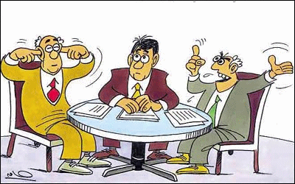
evolution : from an academic design to a real work design
Educational science statement: people learn what they need to work safely  the safety rules/ expectancies must be linked to the work to be more used (and not only respect)
The designer have to introduce
point of “work reference” : when to use the rule (before, during or after the technical work) and in which situations, how to use it …
What about a knowledge without direct link with work ?
Obvious exercise or long debate?
Irradiation risk or external exposition ?
Different kinds of fire extinguisher or just “in case of fire, call the 18”?
Notes:
If it can be “easy” to associate rule with its utility, this exercise leads also to change the global design of the training and the lessons….As you already know, adults are characterized by an existing experience and you have to use it to create “reference” with this experience to help trainees to understand when and how “place” these rules into their work experiences. Doing these links betweens these general safety rules and their work, you facilitate the future use.
A very simple example about the needs of giving reference relates to the rule “ you must fill out the document called “identification of risk and means to prevent risk ”. Workers are expected to hang up this document on their work area to inform, your team and everybody, about the risks.
To train to this rule , workers need a lot of information about…:
The document which identify the safety equipment
Who provide the document ?
When the document is available ?
What to do when the document in case of a lack of data?
Where do I find the material ?
Are things different if I work within radiological area?
What ‘s the best place to hang up the document ,
What I have to do if I loose it or if the document is damaged?
But we can also take an other example, when we talk about radiological risk. We know that people have already heard about them and that even if they never work in a NPP. So if we consider their experiences, what’s the best word to talk about irradiation : Is irradiation “a common word” or an expert vocabulary “ an external exposition without contact” ? This king of example allows me to address a case in which “rules makers” have to make effort and to accept an adaptation…So this kind of example can lead as well as obvious exercize or intense debate.

Slide 13
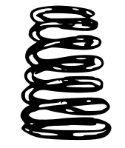
evolution : the “abnormal situation”, a new component of the training
Postulated situation
Real situation
The dose rate measured is “quite” the same of the dose rate written on the work permit
The job will be longer than predicted
The name of the worker do not match with the one on the formal authorization
Formal behavior
adaptation
Expected results
Real results
We aim to develop a global behavior of “questioning attitude” and communication practices to avoid some drifts become a cause of incident : storytelling, case studies, practical training to abnormal situations, and so on.
Notes:
Let me know tell you about the fourth evolution.
If you take into account the real work experience of workers, you quickly act that real work is not the formal or the predicted work : something different always happens. Therefore, when EDF decided to design a training useful trainers EDF decided also to integrate the real work which is characterized by “abnormal situation”
“abnormal situation” refers to hazards, unexpected events, degradation, weak signal. There are different from deviation and gap, or emergencies situations.
Now, rules relates often to normal work situations and emergencies
So how to integrate that ?
According to social sciences and knowledge, we identify as much as possible these “little problem”, these weak signal, the drifts that workers are supposed to face during the work and we create case studies, we use storytelling to teach them how to face, to fix, to manage these abnormal situations.
Educational sciences results : Adults learn by
“doing experiences”but we can’t expose learners to events!
resolving problem, enigma, and so on.
Purpose : an relevant and real event is transformed in a “springboard” story to lead learner to analyze an event and to explore what could be done to avoid this event ?
After the story, a debate is leaded with three main questions:
According to you, how this event happened ?
According to you, how this event could be prevent ?
Do you consider to be expose to similar work situation ?(springboard effect)

Slide 14
conclusions
1.The postulate : the design should be adapt as much as possible to the trainees and their work (and not the trainees must adjust to the training level) : a design based on the real job, the sense of the rule as guide, the abnormal situations, a change of vocabulary…
2. The design process is finished
3. This first tests lead to positive results :
Trainers : “we bring to the trainees more precise data and we observe the development of better practices and a “prevention attitude”
4. This evolution calls for “cultural” evolutions :
  Design process and designers
  Relation between the trainers and the trainees: the trainers do not transfer data, they build a way to think and to work within a NPP
  The training job and tools must enhance active methods (study cases, problem resolutions)
5. Now a never-ending story begins : the steering change and the continuous improvement with …12 training companies, 250 trainers…. (train the trainers….)
Notes:
To conclude, this project tried to take into account a human factor orientation based on 4 “instruction” : a design based on the real job, the sense of rule as a guide to facilitate its use, the integration of abnormal situations and also a change of vocabulary.
Now the project is quite finished. The starting up is forecasted in September. We have done experimental sessions with real workers groups and the results were positive.
We know that this king of project calls for some “cultural changes”. That’s the reason why EDF will be face an other big challenge : the steering change with the training centers and the trainers and also the needs for the continuous improvements…

Slide 15
Change for what ?
THANKS

