Slide 1


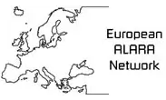
15th European ALARA Network Workshop and 5th EUTERP Workshop
Education and Training in Radiation Protection
Improving ALARA Culture
7-9 May 2014, Rovinj, Croatia
Greek Atomic Energy Commission initiatives with respect to education and training of outside workers
C. Pafilis, M. Kalathaki, K.L. Karfopoulos, E. Carinou, S. Economides

Slide 2


Regulatory Requirements for E&T in Radiation Protection
The Greek Radiation Protection Regulations:
All persons involved in radiological procedures must have knowledge on RP (theoretical and practical training).
The competence of the personnel working in radiation facilities and activities must be checked before issuing (or renewing) the operation license of a facility
Provisions for QE/RPE, RPO, MPE – recognition requirements
GAEC issues certificates of competency on RP for occupationally exposed personnel (exams, cvs, personal interviews)
GAEC recognizes syllabi on RP.

Slide 3
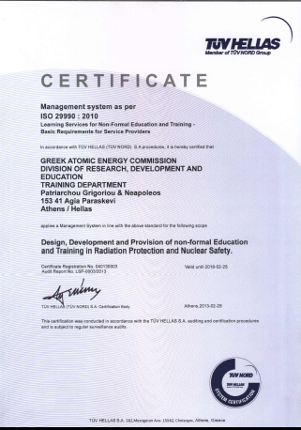
ISO 29990:2010
An effective national programme on E&T in RP assumes that the E&T provider, has a well established Quality Management System (QMS).
The ISO 29990:2010 is
a generic model for quality professional practice and performance
a common reference for learning service providers
in the: design, development and delivery of
non-formal education

Slide 4
ISO 29990:2010
Learning Services
Management
The QMS adopted is oriented to the vision and the mission of GAEC while focuses on:

Slide 5
ISO 29990:2010
E&T services
Determine the learning needs
Design the learning Service
(e.g. learning outcomes, curriculum, teaching methods, teaching material, lecturers and participants criteria, exams)
Provide the learning service
(iv) Monitor delivery and evaluate of the learning service
E&T services
Learning Needs
Design
Provide
Evaluate

Slide 6
Outside Workers
‘Outside worker’
means any exposed worker who is not employed by the undertaking (operator) responsible for the supervised and controlled areas, but performs activities in those areas, including, apprentices and students.
‘Outside Undertaking’ (employer)
is considered any natural or legal person, other than the operator, including member of his staff, performing an activity of any sort in a controlled area.

Slide 7
Outside Workers
Several issues have been raised with respect to outside workers involving:
the monitoring of their doses, and who is responsible for summing the doses received at different facilities and checking if the annual dose limits have been exceeded;
their education, training and information in radiation protection;
the localization of any possible overexposure.
Regulatory Authorities
Outside undertakings
Operators
Responsibility

Slide 8

Outside Workers
establish specific mechanisms for the reporting or authorization of the outside undertakings
ensure that the system for individual radiological monitoring affords outside workers equivalent protection to that for exposed workers employed on a permanent basis.
Regulatory Authorities

Slide 9
Current situation in Greece
There are no nuclear facilities and outside workers provide their services mainly to public and private medical facilities
  Technicians performing the installation, maintenance and servicing of radiology, nuclear medicine and radiotherapy systems as well as the cyclotron installation
  Staff providing assistance during interventional procedures (pacemaker and stent positioning, orthopedics etc)
  Personnel undertaking the installation/replacement of radioactive sources
The outside undertakings must be licensed to allow their employees to provide services in controlled areas
GAEC in order to license the outside undertakings, performs on-site inspection at their installations to verify compliance with the existing requirements in terms of radiation protection
  If compliance is verified, GAEC issues a license which is valid for 5 years
During the on-site inspections at the installations of operators, GAEC ensures that the operators provide the required operational aspects of the radiation protection of outside workers that are directly related to the nature of their activities

Slide 10
Defining the Learning needs
What they know and do
What they SHOULD know and do
On-site Inspections
Legislative framework
Directive 2013/59/Euratom
Directive 90/641/Euratom
Directive 80/836/Euratom
Government Gazette, Ministerial Decision No.9087(FOR) 1004: “Protection in practice of outside workers exposed to ionizing radiation during their activities in controlled areas”
Hellenic Radiation Protection Regulations

Slide 11
Defining the Learning needs
What they know and do
What they SHOULD know and do
On-site Inspections
Some outside workers:
  Do not use their electronic dosemeter
  Own a radiation passport without having an electronic dosemeter
  Use their personal electronic dosemeter as survey meters
  Do not keep their radiation passport informed
Legislative framework
Directive 2013/59/Euratom
Directive 90/641/Euratom
Directive 80/836/Euratom
Government Gazette, Ministerial Decision No.9087(FOR) 1004: “Protection in practice of outside workers exposed to ionizing radiation during their activities in controlled areas”
Hellenic Radiation Protection Regulations

Slide 12
Defining the Learning needs
What they know and do
What they SHOULD know and do
On-site Inspections
Some outside workers:
  Do not use their electronic dosemeter
  Own a radiation passport without having an electronic dosemeter
  Use their personal electronic dosemeter as survey meters
  Do not keep their radiation passport informed
Lack of appropriate training on RP as well as ALARA/Safety culture
Legislative framework
Directive 2013/59/Euratom
Directive 90/641/Euratom
Directive 80/836/Euratom
Government Gazette, Ministerial Decision No.9087(FOR) 1004: “Protection in practice of outside workers exposed to ionizing radiation during their activities in controlled areas”
Hellenic Radiation Protection Regulations

Slide 13

Defining the Learning needs
What they know and do
What they SHOULD know and do
On-site Inspections
Some outside workers:
  Do not use their electronic dosemeter
  Own a radiation passport without having an electronic dosemeter
  Use their personal electronic dosemeter as survey meters
  Do not keep their radiation passport informed
Lack of appropriate training on RP as well as ALARA/Safety culture
The involved parties (undertakings, workers, operators) are unaware of the existing legislative framework or are not fully aware of roles and responsibilities
Legislative framework
Directive 2013/59/Euratom
Directive 90/641/Euratom
Directive 80/836/Euratom
Government Gazette, Ministerial Decision No.9087(FOR) 1004: “Protection in practice of outside workers exposed to ionizing radiation during their activities in controlled areas”
Hellenic Radiation Protection Regulations
Notes:
και καμία γνώση για την ύπαρξη σχετικής νομοθεσίας

Slide 14

Design of a training programme
Parameters of the training programme
Duration: 8 hours
Educational level of participants: Secondary school at least
Lectures qualifications:
  GAEC has a pool of highly qualified and experienced lecturers (most of them are Medical Physicists)
  Cooperation with universities and research centers is always possible
A syllabus was decided
Lesson plans were prepared
Learning objectives:
  To be aware of the harmful effects of radiation
  To recognize radiation risks in workplace
  To adopt radiation protection ‘good practices’
  To understand their role and responsibilities
  To develop a ‘safety culture’

Slide 15

Syllabus
Fundamentals
  1.1 The physics of ionizing radiation
  1.2 Ionizing radiation detection systems
  1.3 Dosimetry
  1.4 Biological Effects of ionizing radiation
  1.5 Radiation Protection System
  The current legislative framework regarding outside workers
  Licensing procedure for outside undertakings
  Practical aspects of Radiation Protection for outside workers
    2.1 Diagnostic and Interventional Radiology
    2.2 Nuclear medicine
    2.3 Radiotherapy
→ 4 h
→ 4 h
Lesson plan example

Slide 16
Lesson Plan
2.1 Diagnostic and Interventional Radiology
Type | Classroom based training
Learning Outcome | Basic awareness of the principles of radiation protection and the application of best practices in diagnostic and interventional radiology
Learning Objectives | The participant will be able to do the following: Apply basic concepts of radiation protection (i.e. the behavior of the factors of time, distance, shielding) Apply practical methods for reducing doses Be able to distinguish good from bad practices
Content | Radiation Protection Principles (distance, time, shielding) Scattered radiation and leakage radiation Applying RP Principles – Best practices (control room, shielded doors, installation of new systems, lead apron, thyroid collar, glasses, personal dosimeter) Examples of RP bad practices Practices reducing the dose exposure of outside workers Accidents
Duration | 1 h
Equipment | Power Point, video projector
Available Material | Lecture Notes, Notebook (available via www.gaec.gr)

Slide 17

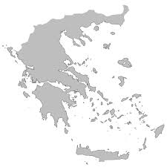
Provision of the programme
3 seminars have been conducted
  2 in Athens, 1 in Thessaloniki
6 different lectures (Medical Physicists)
60 outside workers out of 239 registered in the
National Radiation Protection Database attended
the seminars
Thessaloniki [1]
Athens [2]

Slide 18
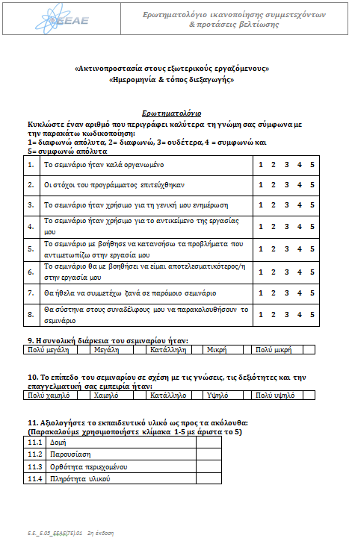
Evaluation of the programme
Feedback from the participants by filling a questionnaire
Feedback from the lecturers by filling a questionnaire
Questions are related inter alia to the
  Structure of the seminar
  Presentations
  Learning objectives
Mean results >4.5 for all the questions

Slide 19
Conclusions
The initiative taken was considered successful and that contributes significantly in the enhancement of the national radiation protection system and that supports the development of ALARA/Safety culture among the involved parties
Initiatives like this are going to be continued
More actions like distance learning courses, dissemination of informative material, continuous communication with related professional bodies should also be taken

Slide 20
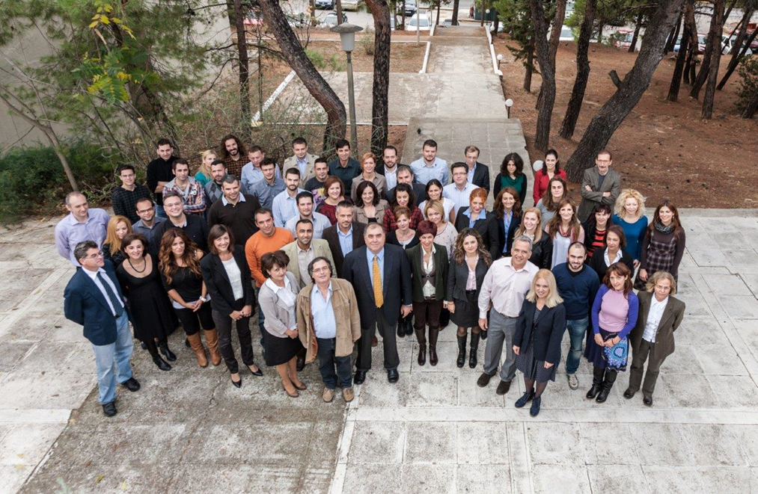
Thank you very much for your attention!!!
Greek Atomic Energy Agency
P. O. Box 60092
Agia Paraskevi 15310, Athens
T: 210 650 6700
F: 210 650 6748
E: info@eeae.gr
www.eeae.gr
www.facebook.com/eeaegr
www.twitter.com/#eeaegr

